Slide 1







An Experimental Survey on Big Data Frameworks
W. Inoubli, S. Aridhi, H. Mezni, M. Maddouri, E. Mephu Nguifo

Slide 2
Outline
Context and motivations
Overview of Big Data Framewoks
Experimental study
Best practices
Conclusion

Slide 3
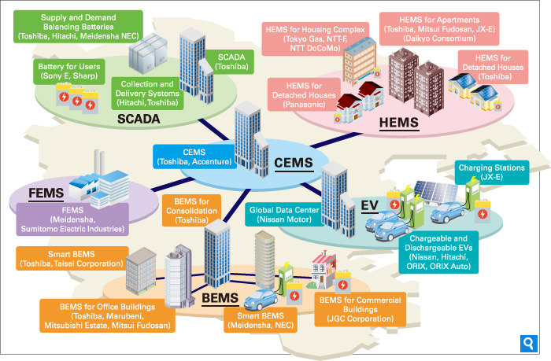

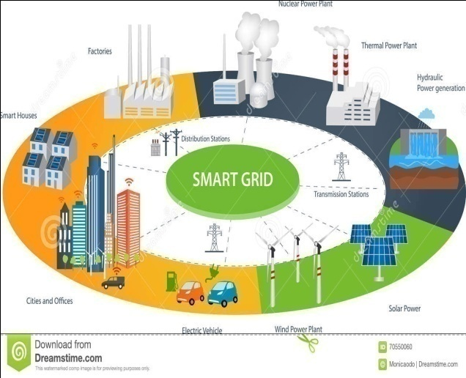

Context and motivations(1)

Slide 4
Context and motivations(2)
Volume of data
2.5 trillion bytes of data are generated everyday [7]
90% of the data created in the world have been created in the last 2 years [7]
Multiple data sources
Sensors, social media, images, videos, online shopping, GPS signals
Various data format
Relational DBMS, structured data (Xml, Json), NOSQL Databases, …

Slide 5
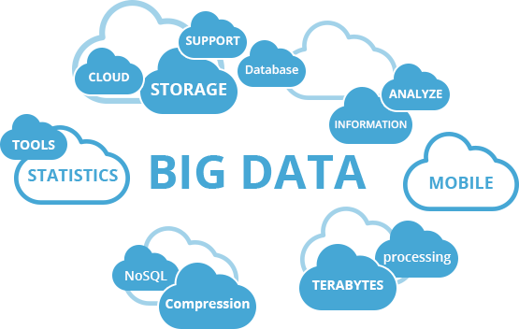
Context and motivations (3)
Big Data problems and challenges:
Scalability
Fault tolerance
Storage
Several Big Data frameworks have been proposed

Slide 6




Context and motivations (4)

Slide 7
Related Works
Related works | Programming Mode | Study Frameworks | Comments
Dede et al., 2014, Future Generation Computer Systems | Batch | Hadoop LEMO-MR Twister | Comparison of several MapReduce implementations
Zhang et al., 2015, IEEE TKDE | Batch | Spark | Linear scaling Data partitioning Theorical study
Veiga et al., 2016, 2016 IEEE Big Data | Batch | Flink Spark Hadoop | Several workload
Zhang et al., 2017, IEEE ICDE | Stream | Flink Spark Storm | Several Complex Events Processing (CEP) presented
Chen et al., 2014, Information Sciences Chen et al.,2014, Mobile Networks and Applications | Batch and Stream | Hadoop Storm | Only theoretical study

Slide 8
Related works
Weak points and limits:
  No thorough studies in resources consumption for all frameworks
  Impact of the associated parameters on the performance of the studied frameworks is not well studied
  No best practices provided
Challenges:
  Categorization of popular Big Data frameworks based on their features
  Experimental study:
    Batch computing
    Stream processing
    Resources consumption
  Best practices based on our theoretical and empirical study

Slide 9
Categorization of popular Big Data frameworks
 | Hadoop | Spark | Storm | Flink
Data Format | Key-value | RDD | Key-value | Key-value
Programming mode | Batch | Batch and Stream | Stream | Batch and Stream
Data sources | HDFS | HDFS, DBMS and Kafka | HDFS, HBase and Kafka | Kafka, Kinesis, message queus, socket streams
Programming model | Map and Reduce | Transformation and Action | Topology | Transformation
Pogramming languages | Java | Java, scala and python | Java | Java
Cluster manager | YARN | YARN, mesos, Standalone | Zookeeper | YARN ,Standalone
Comments | Stores large data in HDFS | Gives several APIs to develop interactive applications | Suitable for real-time applications | An extension of MapReduce with graph methods
A comparative study of popular Big Data frameworks

Slide 10
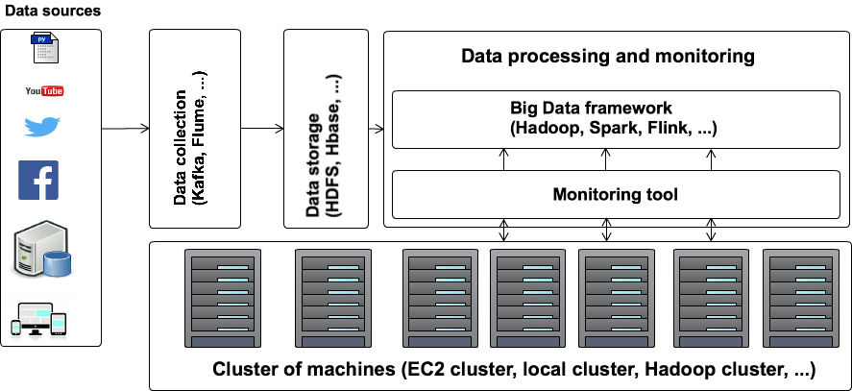
Experimental protocol (1)
Batch Mode evaluation
Workload: kmeans, WordCount and PageRank.
Frameworks: Hadoop (Mapreduce), Spark and Flink.
Features: Scalabilty, Configuration parameters.

Slide 11
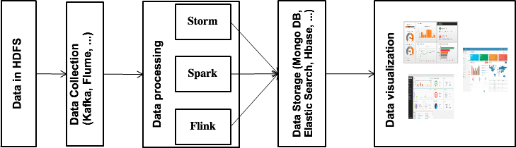
Experimental protocol (2)
StreamMode evaluation
Workload: ETL Workload
Frameworks: Storm, Spark and Flink
Features: Number of processed events

Slide 12
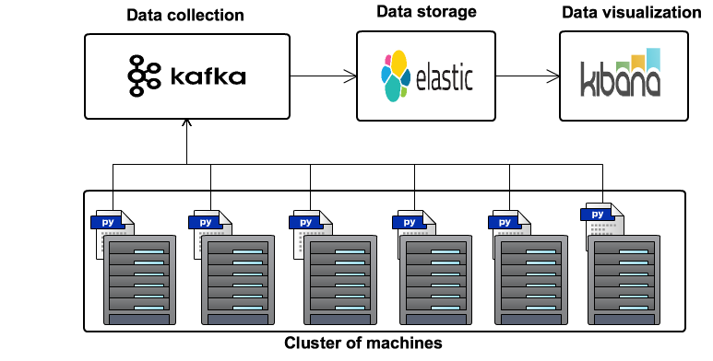
Experimental protocol (3)
Monitoring Tool:
Data collection: Kafka
Data Strorage: ElasticSearch
Data Visualisation: Kibana

Slide 13
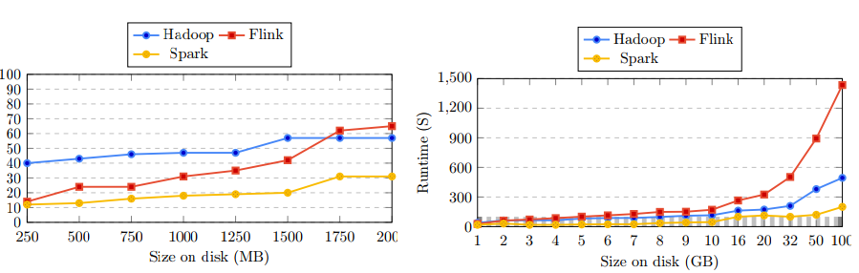
Experimental results (1)
Batch Mode results:
(a) Small datasets (WordCount workload)
(b) Big datasets (WordCount workload)
Impact of the size of data on the response time
Spark is better when we use a small dataset and Hadoop is the best for big datasets

Slide 14
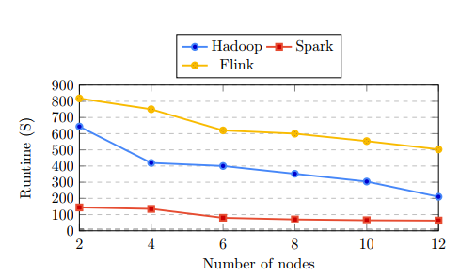
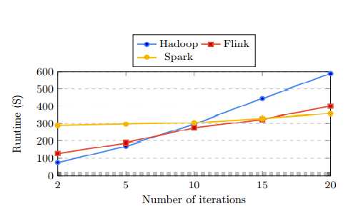
Experimental results (2)
Batch Mode results:
Vary the number of machines in cluster (Wordcount workload and 50 GB of data)
Scalability study
k-Means workload with10000 training examples
Vary the number of iterations

Slide 15
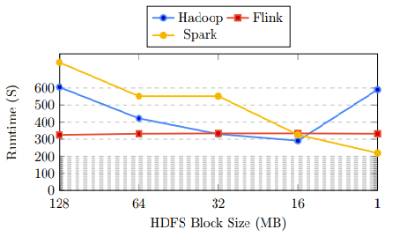
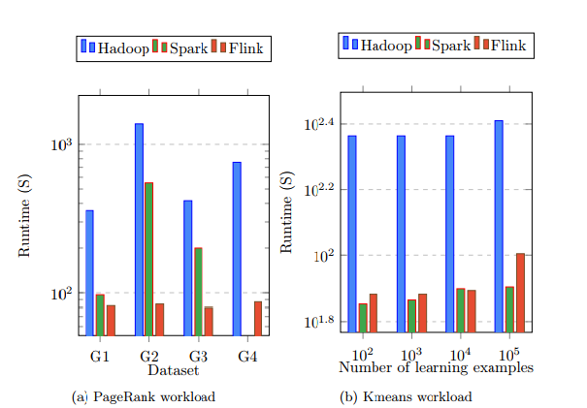
Experimental results (3)
Batch Mode results:
Vary the size of HDFS block
Study the partitioning of data
WordCount workload and 50 GB of data
Iterative workloads (PageRank and Kmeans)
Vary the number of iterations
Spark and Hadoop are influenced by data partitioning
Flink perfoms well in the case of In memory applications

Slide 16
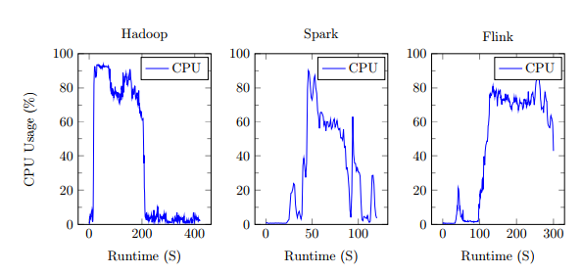
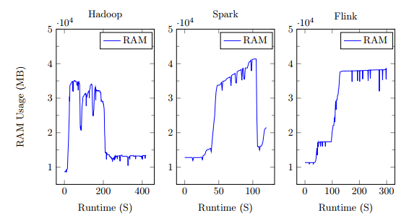
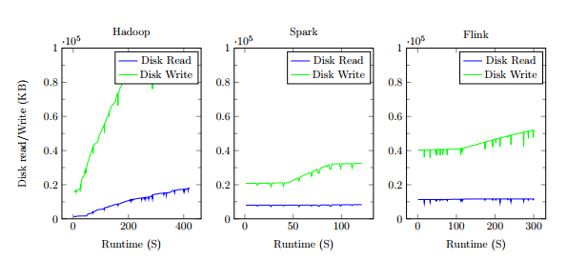
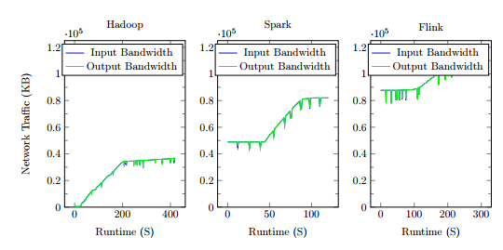
Experimental results (4)
Resources consumption in Batch mode (WordCount workload and 50 GB of data):
RAM resource usage
CPU resource usage
Disk Write/Read resource usage
BW resource usage

Slide 17
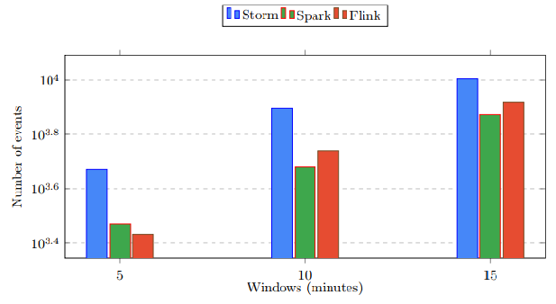
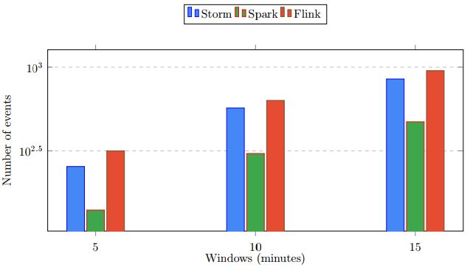
Experimental results (5)
Stream Mode results :
Event with 100 kb
Event with 500 kb
Impact of the size of messages on the number of processed messages
An ETL workload is used
Storm performs better in the case of small datasets
Flink provides good results in the case of big datasets

Slide 18
BEST PRACTICES
Lambda architecture:
  Recommended frameworks: Spark and Flink
  Spark and Flink ensure both Batch and Stream processing
Micro-batch processing:
  Recommended frameworks: Spark
  The features of RDD concept
Recommendation systems and big data mining applications:
  Recommended frameworks: Spark, Flink and Hadoop
  They provide specific APIs for these use cases
Smart cites and social media:
  The associated data in mainly stream data
  Storm and Flink could be used

Slide 19
Conclusion
An overview of Big Data frameworks (Hadoop, Spark, Storm and Flink)
We have identified the features of each framework
An experimental study of the studied frameworks
Best practices

Slide 20
References
[1] Dede, E., Fadika, Z., Govindaraju, M., & Ramakrishnan, L. (2014). Benchmarking MapReduce implementations under different application scenarios. Future Generation Computer Systems, 36, 389-399.
[2] Zhang, H., Chen, G., Ooi, B. C., Tan, K. L., & Zhang, M. (2015). In-memory big data management and processing: A survey. IEEE Transactions on Knowledge and Data Engineering, 27(7), 1920-1948.
[3] Veiga, J., Expósito, R. R., Pardo, X. C., Taboada, G. L., & Tourifio, J. (2016, December). Performance evaluation of big data frameworks for large-scale data analytics. In Big Data (Big Data), 2016 IEEE International Conference on (pp. 424-431). IEEE.
[4] Zhang, S., He, B., Dahlmeier, D., Zhou, A. C., & Heinze, T. (2017, April). Revisiting the design of data stream processing systems on multi-core processors. In Data Engineering (ICDE), 2017 IEEE 33rd International Conference on (pp. 659-670). IEEE.
[5] Chen, C. P., & Zhang, C. Y. (2014). Data-intensive applications, challenges, techniques and technologies: A survey on Big Data. Information Sciences, 275, 314-347.
[6]Chen, M., Mao, S., & Liu, Y. (2014). Big data: A survey. Mobile Networks and Applications, 19(2), 171-209.
[7] Gandomi, A., & Haider, M. (2015). Beyond the hype: Big data concepts, methods, and analytics. International Journal of Information Management, 35(2), 137-144.

Slide 21
Thank you for your attention
Any questions or recommendations?

